Slide 1
Technical Support (420-1N6-AB) User Training
Fall 2021

Slide 2

Give a man a fish… 1

Slide 3

Give a man a fish… 2

Slide 4

Give a man a fish…3

Slide 5
What is Training?
A teaching and learning process that aims to build skills that are immediately useful to the trainees.
Differs slightly to education.
Education is a teaching and learning process that aims to provide conceptual understanding and long-term thinking skills.
Training focuses on performing activities and building expertise that will be immediately useful.

Slide 6
Training vs Education
Basis for Comparison | Training | Education
Meaning | The process of inculcating specific skills in a person is training. | Theoretical learning in the classroom or any institution is education.
What is it? | It is a method of skill development. | It is a typical form of learning.
Based on | Practical application | Theoretical orientation
Perspective | Narrow | Wide
Involves | Job experience | Classroom learning
Term | Short term | Comparatively long term
Prepares for | Present job | Future job
Objective | To improve performance and productivity. | To develop a sense of reasoning and judgement.
Teaches | Specific task | General concepts
https://keydifferences.com/difference-between-training-and-education.html

Slide 7
Training Process
Plan
Prepare
Present
Progress

Slide 8
Step 1: Plan
Determine the trainees’ backgrounds.
Determine the trainees’ content needs.
Determine the skill level trainees need.
Concepts, understanding, skills, expertise.
Determine what trainees already know.
Define the training objectives
Learning objectives and performance objectives.
Using this information, produce a training plan.

Slide 9
Step 2: Prepare (I)
Specify which topics will be covered.
What should be included.
What should be excluded.
Organize the topics.
Start with lower-level skills and progress to higher-level skills.
Introduce concepts, followed by explanations to enhance understanding.
Finally, build basic skills and abilities.
Use exercises to build expertise.
Select the training method.
e.g. classes, small groups, one-to-one, self-guided.

Slide 10
Step 2: Prepare (2)
Select delivery systems for the for the training materials.
e.g. lecture, group discussion, hands-on activities, demonstrations, visual aids, CBT, WBT.
Develop specific training materials.
Design training evaluation methods
Trainee evaluation
Trainer assessment.

Slide 11
Step 3: Present
Practice the presentation.
Arrive early to check the facility.
Don’t read notes or try to cover too much material.
Teach the most important skills and stop for comprehension checks.
Monitor the training environment.
Provide frequent breaks.

Slide 12
Step 4: Progress toward quality
Obtain feedback from trainees.
After each training session, trainers should review the feedback received and evaluate their own performance.
They should then modify their presentation style or training materials if necessary, to correct any problem areas identified.

Slide 13
Oral Presentations

Slide 14
1. Prepare
Plan your presentation.
Plan your visuals.
Design your visuals.

Slide 15
Using Visual Aids
Help you cover more ground in less time.
Show reality in ways that words alone cannot portray.
Help the audience to visualize abstract concepts.
Make a dry subject interesting.

Slide 16


Slide 17
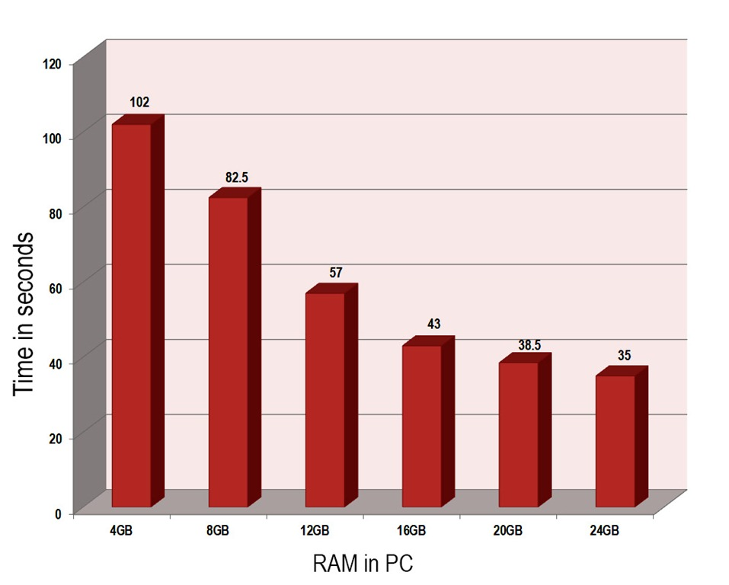

Slide 18
Using Text
Use keywords and phrases only.
Use text to show the main ideas/points and not the full detail about each.
Use clear fonts that are easy for the audience to read.
Don’t cram too much information onto one slide.
Make sure that charts and images are clear to read, and relevant to your presentation.

Slide 19
LIMIT THE NUMBER OF WORDS AND USE LARGE, BOLD LETTERS. A GOOD GUIDELINE FOR TEXT-BASED VISUALS IS SIX TO EIGHT WORDS PER LINE AND NO MORE THAN FIVE TO SEVEN LINES PER VISUAL. EDIT OUT WORDS YOU WON’T NEED UNTIL EACH STATEMENT IS AS CONCISE AND TO-THE-POINT AS POSSIBLE. ALL UPPERCASE IS HARD TO READ AND THERE IS FAR TOO MUCH TEXT ON THIS SLIDE MAKING IT IMPOSSIBLE TO FOLLOW.

Slide 20
2. Practice
Rehearsing provides many benefits.
Practice delivering your presentation with your visual aids.
Take care with your timing.

Slide 21
2. Performance
Handle your body language accordingly.
Make eye contact with your audience.
Speak clearly and confidently with limited “filler” words.
Stick to your time limits and deal with questions appropriately.
Provide your audience with a “take-home” message.

Slide 22
Visual aids are intended to support you, not replace you!

